Slide 1
Understanding Features

Slide 2
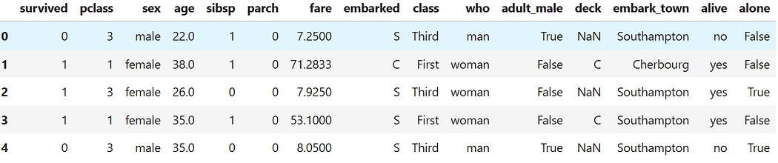
Data Features…..
‘titanic’ dataset in seaborn

Slide 3
Learning Objectives
By the end of this session, you will be able to:
Define categorical, discrete, and continuous features.
Understand the differences and significance of each type.
Explore examples with real-world datasets.
Use Python (Pandas, NumPy, Matplotlib, Seaborn) for data exploration.

Slide 4
Types of Features
1. Categorical Features: Represent labels or categories (e.g., gender, country).
1
2. Discrete Features: Represent countable values (e.g., number of children).
2
3. Continuous Features: Represent measurable values (e.g., height, salary).
3

Slide 5
Categorical Features
Definition: Features that represent categories or groups.
Examples:
- Gender: Male, Female
- Car Type: Sedan, SUV, Truck
- Payment Method: Credit Card, Cash, Digital Wallet

Slide 6
Data Features…..
Which of these are Categorical features?

Slide 7
deck | Categorical | Nominal | Represents the deck letter (A, B, C, etc.). While there might be a physical order, the deck itself is often treated as a set of distinct, unordered groups in analysis unless more context is given.
embark_town | Categorical | Nominal | Full name of the port of embarkation (Southampton, Cherbourg). No inherent order.
embarked | Categorical | Nominal | Represents the port of embarkation (S, C, Q). The ports have no inherent order.
sex | Categorical | Nominal | Represents distinct, unordered groups (male, female).
who | Categorical | Nominal | Represents a category (man, woman, child).
adult_male | Categorical | Nominal (or Binary/Dichotomous) | A logical category (True/False) indicating if the person is an adult male.
alive | Categorical | Nominal (or Binary/Dichotomous) | A category (yes/no) for survival.
alone | Categorical | Nominal (or Binary/Dichotomous) | A logical category (True/False) indicating if the person was alone.
survived | Categorical | Nominal (or Binary/Dichotomous) | Represents a group (survived/not survived). The numbers (0 and 1) are just labels for the categories.
class | Categorical | Ordinal | Text representation of pclass (First, Second, Third), showing a meaningful order.
pclass | Categorical | Ordinal | Represents the passenger class (1st, 2nd, 3rd). The classes have a meaningful, ordered ranking.

Slide 8
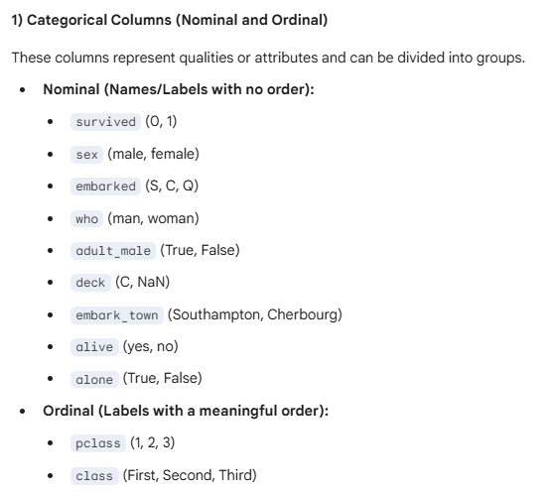
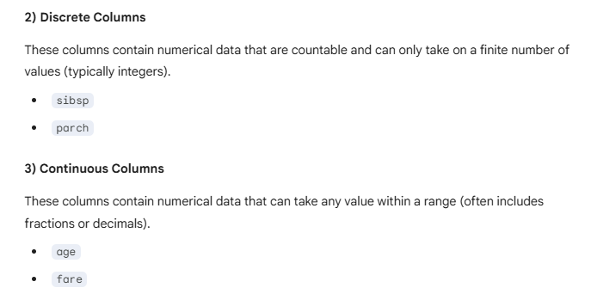

Slide 9
Types of Categorical Features
1. Nominal: No specific order (e.g., colors: Red, Blue, Green).
2. Ordinal: Has an inherent order (e.g., education levels: High School, Bachelor’s, Master’s).

Slide 10
Discrete Features
Definition: Numerical features that take countable, finite values.
Examples:
- Number of children in a family
- Number of products purchased
- Number of login attempts

Slide 11
Data Features…..
Which of these are Discrete features?

Slide 12
parch | Discrete | Ratio | Count of parents/children aboard. It must be an integer and the value of 0 is a true zero.
sibsp | Discrete | Ratio | Count of siblings/spouses aboard. It must be an integer and the value of 0 is a true zero.

Slide 13

Mathematical Properties of Discrete Features
Countable values with no intermediate values.
Follows probability mass functions (PMF).
Example: Number of calls received per day:

Slide 14
Continuous Features
Definition: Numerical features that can take any value within a range.
Examples:
- Height and weight
- Temperature and pressure
- Income and expenses

Slide 15
age | Continuous | Ratio | Can take any value within a given range (e.g., 22.0, 38.0). Zero is an absolute minimum.
fare | Continuous | Ratio | Can take any value within a given range, representing cost.

Slide 16


Mathematical Properties of Continuous Features
Can take infinite values within a range.
Follows probability density functions (PDF).
Example: Height of individuals:

Slide 17
Python Implementation
‘titanic’ dataset in seaborn

Slide 18
Multiple Choice Questions (MCQs)
Q1: Which feature type is used to represent customer feedback: “Satisfied,” “Neutral,” “Dissatisfied”?
A) Categorical
B) Discrete
C) Continuous
D) Ordinal
Q2: The number of books a person owns is an example of which feature type?
A) Categorical
B) Discrete
C) Continuous
D) Ordinal

Slide 19
Multiple Choice Questions (MCQs)
Q1: Which feature type is used to represent customer feedback: “Satisfied,” “Neutral,” “Dissatisfied”?
A) Categorical ✅
B) Discrete
C) Continuous
D) Ordinal
Q2: The number of books a person owns is an example of which feature type?
A) Categorical
B) Discrete ✅
C) Continuous
D) Ordinal

Slide 20
Fill in the blanks
1. ______ features represent categories or groups.
2. A ______ feature can take any value within a range.
3. The count of items purchased is an example of a ______ feature.

Slide 21
Fill in the blanks
1. ______ features represent categories or groups. (Answer: Categorical)
2. A ______ feature can take any value within a range. (Answer: Continuous)
3. The count of items purchased is an example of a ______ feature. (Answer: Discrete)

Slide 22
Session Summary
In this session, we have discussed about:
Define categorical, discrete, and continuous features.
Understand the differences and significance of each type.
Explore examples with real-world datasets.
Use Python (Pandas, NumPy, Matplotlib, Seaborn) for data exploration.

Slide 23
Sample E-commerce Order Dataset
Order_ID | Product_Category | Review_Score | Quantity | Price_Per_Unit | Delivery_Region | Discount_Applied | Customer_Age
1001 | Electronics | 5 | 1 | 499.99 | North | True | 34
1002 | Clothing | 3 | 2 | 45.50 | South | False | 22
1003 | Books | 4 | 5 | 12.99 | West | False | 58
1004 | Home Goods | 1 | 1 | 89.00 | East | True | 41
1005 | Electronics | 5 | 1 | 129.99 | West | False | 29
1006 | Clothing | 4 | 3 | 25.00 | North | True | 67
1007 | Books | 2 | 10 | 8.50 | South | False | 19
1008 | Home Goods | 5 | 1 | 350.75 | East | False | 50
1009 | Clothing | 3 | 2 | 65.99 | North | False | 38
1010 | Electronics | 4 | 1 | 199.99 | West | True | 45

Slide 24
Column | Feature Type | Sub-Type | Reasoning
Order_ID | Categorical | Nominal | Unique identifier/label. No inherent order or numerical meaning.
Product_Category | Categorical | Nominal | Distinct, unordered groups (Electronics, Clothing, etc.).
Review_Score | Categorical | Ordinal | Scores (1 to 5) have a meaningful, ordered ranking.
Quantity | Discrete | Ratio | Countable, whole number of items sold.
Price_Per_Unit | Continuous | Ratio | Can take any value within a range (includes decimals like 499.99).
Delivery_Region | Categorical | Nominal | Distinct, unordered geographical labels.
Discount_Applied | Categorical | Nominal (Binary) | A yes/no or True/False label.
Customer_Age | Discrete | Ratio | Countable, whole number of years (often treated as continuous for modeling purposes, but technically a count).

Slide 25
The Iris dataset contains 150 observations (rows) of Iris flowers, with three species observed. For each flower, it records four features related to the physical dimensions of its petals and sepals, plus the species itself.
Iris dataset
sepal length (cm) | sepal width (cm) | petal length (cm) | petal width (cm) | species
5.1 | 3.5 | 1.4 | 0.2 | setosa
4.9 | 3.0 | 1.4 | 0.2 | setosa
4.7 | 3.2 | 1.3 | 0.2 | setosa
4.6 | 3.1 | 1.5 | 0.2 | setosa
5.0 | 3.6 | 1.4 | 0.2 | setosa
5.4 | 3.9 | 1.7 | 0.4 | setosa
4.6 | 3.4 | 1.4 | 0.3 | setosa
5.0 | 3.4 | 1.5 | 0.2 | setosa
4.4 | 2.9 | 1.4 | 0.2 | setosa
4.9 | 3.1 | 1.5 | 0.1 | setosa
Notes:
A very popular and beginner-friendly dataset, often used for machine learning and data type identification, is the Iris dataset. It's smaller than the Titanic dataset but contains excellent examples of the feature types you're focusing on.

Slide 26
Column | Example Values | Feature Type | Sub-Type | Reasoning
sepal_length | 5.1, 4.9, 7.0 | Continuous | Ratio | Can take any value within a range; measured physical dimension.
sepal_width | 3.5, 3.0, 3.2 | Continuous | Ratio | Can take any value within a range; measured physical dimension.
petal_length | 1.4, 1.4, 5.1 | Continuous | Ratio | Can take any value within a range; measured physical dimension.
petal_width | 0.2, 0.2, 1.8 | Continuous | Ratio | Can take any value within a range; measured physical dimension.
species | Setosa, Versicolor, Virginica | Categorical | Nominal | Represents distinct, unordered groups of flowers.

Slide 27
Wine Quality Data
fixed_acidity | volatile_acidity | citric_acid | residual_sugar | chlorides | free_sulfur_dioxide | total_sulfur_dioxide | density | pH | sulphates | alcohol | quality
7.4 | 0.70 | 0.00 | 1.9 | 0.076 | 11.0 | 34.0 | 0.9978 | 3.51 | 0.56 | 9.4 | 5
7.8 | 0.88 | 0.00 | 2.6 | 0.098 | 25.0 | 67.0 | 0.9968 | 3.20 | 0.68 | 9.8 | 5
7.8 | 0.76 | 0.04 | 2.3 | 0.092 | 15.0 | 54.0 | 0.9970 | 3.26 | 0.65 | 9.8 | 5
11.2 | 0.28 | 0.56 | 1.9 | 0.075 | 17.0 | 60.0 | 0.9980 | 3.16 | 0.58 | 9.8 | 6
7.4 | 0.70 | 0.00 | 1.9 | 0.076 | 11.0 | 34.0 | 0.9978 | 3.51 | 0.56 | 9.4 | 5
7.4 | 0.66 | 0.00 | 1.8 | 0.075 | 13.0 | 40.0 | 0.9978 | 3.51 | 0.56 | 9.4 | 5
7.9 | 0.60 | 0.06 | 1.6 | 0.069 | 15.0 | 59.0 | 0.9964 | 3.30 | 0.46 | 9.4 | 5
7.3 | 0.65 | 0.00 | 1.2 | 0.065 | 15.0 | 21.0 | 0.9946 | 3.39 | 0.47 | 10.0 | 7
7.8 | 0.58 | 0.02 | 2.0 | 0.073 | 9.0 | 18.0 | 0.9968 | 3.36 | 0.57 | 9.5 | 7
7.5 | 0.50 | 0.36 | 6.1 | 0.071 | 17.0 | 102.0 | 0.9978 | 3.35 | 0.80 | 10.5 | 5

Slide 28
Column | Feature Type | Sub-Type | Reasoning
fixed_acidity | Continuous | Ratio | Represents concentration (g/dm³). It can take any value within a range.
volatile_acidity | Continuous | Ratio | Represents concentration (g/dm³). It can take any value within a range.
citric_acid | Continuous | Ratio | Represents concentration (g/dm³). It can take any value within a range.
residual_sugar | Continuous | Ratio | Represents concentration (g/dm³). It can take any value within a range.
chlorides | Continuous | Ratio | Represents concentration (g/dm³). It can take any value within a range.
free_sulfur_dioxide | Continuous | Ratio | Represents concentration (mg/dm³). It can take any value within a range.
total_sulfur_dioxide | Continuous | Ratio | Represents concentration (mg/dm³). It can take any value within a range.
density | Continuous | Ratio | Represents mass per volume (g/cm³). It can take any value within a range.
pH | Continuous | Interval | A measure of acidity/basicity. Zero is arbitrary (it doesn't mean zero acidity).
sulphates | Continuous | Ratio | Represents concentration (g/dm³). It can take any value within a range.
alcohol | Continuous | Ratio | Represents percentage of alcohol by volume. It can take any value within a range.
quality | Categorical | Ordinal | Represents a score (typically 0-10) where higher values indicate better quality, establishing a meaningful order.

Slide 29
Breast Cancer Diagnosis Data
mean radius | mean texture | mean perimeter | mean area | mean smoothness | diagnosis
17.99 | 10.38 | 122.80 | 1001.0 | 0.11840 | malignant
20.57 | 17.77 | 132.90 | 1326.0 | 0.08474 | malignant
19.69 | 21.25 | 130.00 | 1203.0 | 0.10960 | malignant
11.42 | 20.38 | 77.58 | 386.1 | 0.14250 | malignant
20.29 | 14.34 | 135.10 | 1297.0 | 0.10030 | malignant
12.45 | 15.70 | 82.57 | 477.1 | 0.12780 | malignant
18.25 | 19.98 | 119.60 | 1040.0 | 0.09463 | malignant
13.71 | 20.83 | 90.20 | 577.9 | 0.11890 | malignant
13.00 | 21.82 | 87.50 | 519.8 | 0.12730 | malignant
12.46 | 24.04 | 83.97 | 475.9 | 0.11860 | malignant

Slide 30
Column | Feature Type | Sub-Type | Reasoning
mean radius | Continuous | Ratio | Physical measurement of the cell nucleus, can take any value within a range.
mean texture | Continuous | Ratio | Physical measurement (standard deviation of gray-scale values), can take any value within a range.
mean perimeter | Continuous | Ratio | Physical measurement, can take any value within a range.
mean area | Continuous | Ratio | Physical measurement, can take any value within a range.
mean smoothness | Continuous | Ratio | Local variation in radius lengths, a continuous measurement.
diagnosis | Categorical | Nominal (Binary) | Represents two distinct, unordered groups: malignant (cancerous) or benign (non-cancerous).

Slide 31
T20 Batting Performance Data
Player | Innings | Runs | Balls Faced | Strike Rate | Hundreds | Dismissal Type | Batting Hand
V Kohli | 107 | 4008 | 2905 | 137.90 | 1 | Caught | Right
R Sharma | 140 | 3853 | 2772 | 138.60 | 4 | Bowled | Right
B Azam | 98 | 3698 | 2800 | 132.07 | 3 | Caught | Right
M Rizwan | 85 | 3135 | 2400 | 130.63 | 1 | Run Out | Right
J Buttler | 100 | 2720 | 1850 | 147.03 | 1 | LBW | Right
D Warner | 99 | 2894 | 2000 | 144.70 | 1 | Caught | Left
C Gayle | 79 | 1899 | 1220 | 155.65 | 2 | Stumped | Left
K Williamson | 87 | 2464 | 2050 | 120.19 | 0 | Caught | Right
S Narine | 92 | 1100 | 700 | 157.14 | 0 | Caught | Left
F du Plessis | 50 | 1675 | 1250 | 134.00 | 0 | Bowled | Right

Slide 32
Column | Feature Type | Sub-Type | Reasoning
Player | Categorical | Nominal | A unique name/label used to group statistics.
Innings | Discrete | Ratio | A count of matches batted. Must be a whole number, and 0 is a true zero.
Runs | Discrete | Ratio | A count of runs scored. Must be a whole number, and 0 is a true zero.
Balls Faced | Discrete | Ratio | A count of balls faced. Must be a whole number, and 0 is a true zero.
Strike Rate | Continuous | Ratio | Calculated as $(Runs / Balls Faced) \times 100$. Can take any value within a range (includes decimals).
Hundreds | Discrete | Ratio | A count of innings scoring 100 or more. Must be a whole number.
Dismissal Type | Categorical | Nominal | Represents distinct, unordered groups (e.g., Caught, Bowled, LBW, Run Out).
Batting Hand | Categorical | Nominal (Binary) | Represents two distinct, unordered groups (Right, Left).

Slide 33
Feature Type | Sub-Type | Definition | Example (Dataset) | Formula (If Applicable)
1. Categorical | Nominal (or Binary) | Represents labels, names, or distinct, unordered groups. Numbers used are only for labeling (e.g., 0=no, 1=yes). | sex (male/female), diagnosis (malignant/benign), Dismissal Type | N/A (Based on grouping/labeling)
 | Ordinal | Represents categories that have a meaningful order or rank. The interval between ranks is not necessarily equal or measurable. | pclass (1st, 2nd, 3rd), Review_Score (1 to 5), Quality (0-10 score) | N/A (Based on rank/order)
2. Discrete | Ratio (Count) | Data that are countable and must be whole numbers. The range of possible values is fixed (no values between integers). Zero is a true zero. | Innings, Runs, sibsp (siblings/spouses count) | N/A (Simple count of events)
3. Continuous | Ratio | Data that can take any value within a given range (decimals allowed). Zero means the complete absence of the property. | sepal_length, fare, alcohol, mean radius | Example: Strike Rate $= \frac{\text{Runs}}{\text{Balls Faced}} \times 100$
 | Interval | Data that can take any value within a given range, but zero is arbitrary (it does not mean "nothing"). | pH (A measure of acidity, not a count or true zero amount), Temperature (Celsius/Fahrenheit). | N/A (Based on an established scale without a true zero point)

Slide 34
Reference Links
Python notebook
How to Create Stunning Data Visualizations in Python: Top 10 Techniques to Learn
Mastering Credit Risk Analysis: A Step-by-Step Guide to Descriptive Statistics in Python
How Much Statistics Do You Really Need for Data Science?
Phases of data science and analytics.

